Slide 1
DAC Overview Presentation

Slide 2
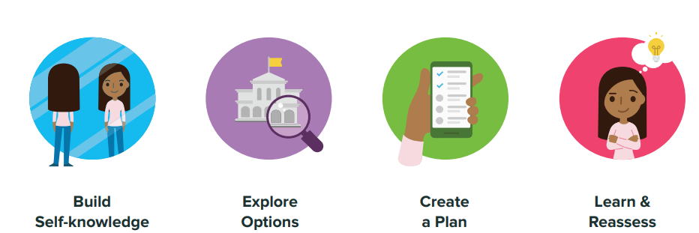
Helping K-12 students become future ready
Built with thousands of hours of research with educators, Xello puts students at the center of their journey of self-discovery and career planning.

Slide 3
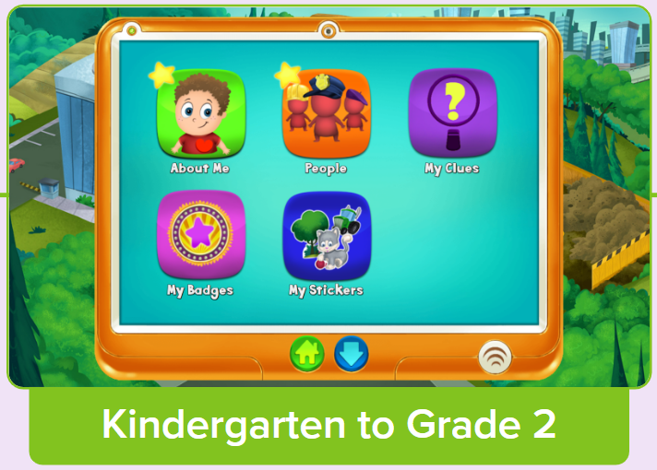
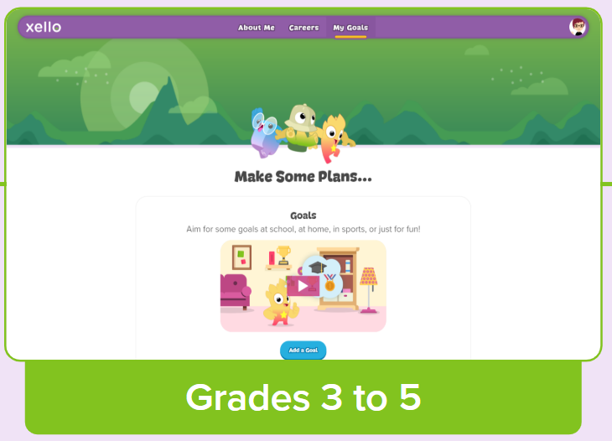
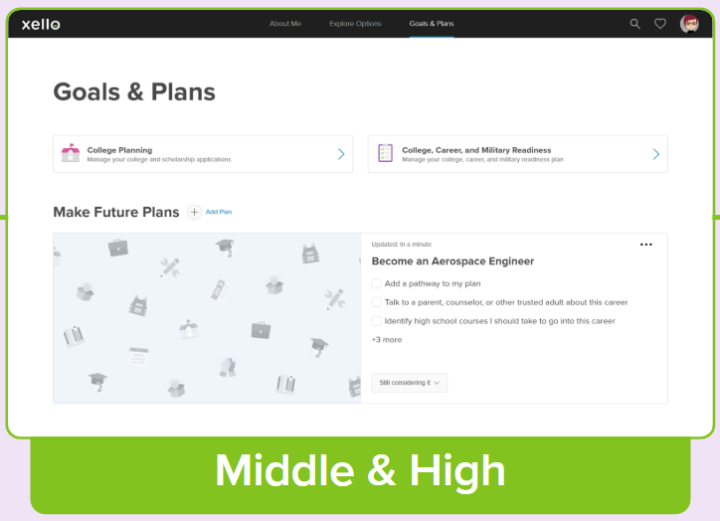
Reach for all grade levels:

Slide 4
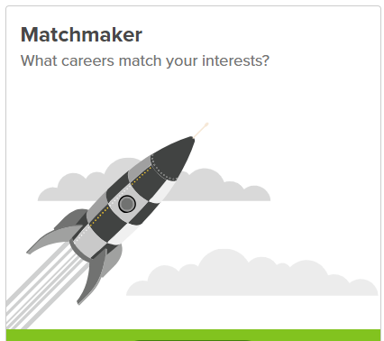
Build Self-knowledge
Students define their interests, skills, preferences, and aspirations so they can explore the opportunities right for them.
What do I enjoy?
What am I good at?
What do I want to do after high school?

Slide 5
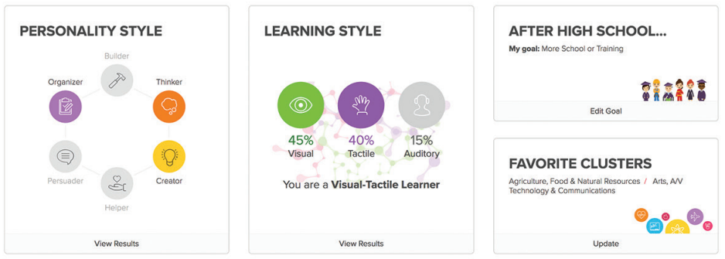
Build Self-knowledge

Slide 6
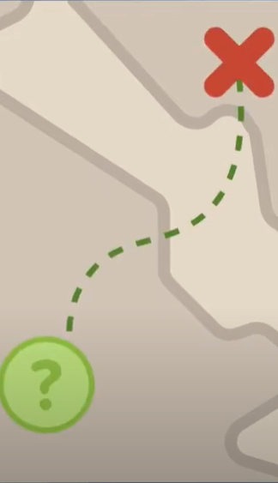
Explore
Explore Careers
Choices are sorted by how well-matched they are to the student.
Sort and sift through a wide variety of career options.
Save their favorite careers on their dashboard.
Explore Schools
Discover various post-secondary learning options.
Learn about enrollment, admission requirements, and tuition costs.
Google Maps with Street View to take virtual tours
Explore Majors
Learn about the post-secondary education needed to achieve their career goals.
Save as favorites to view or edit them later.

Slide 7
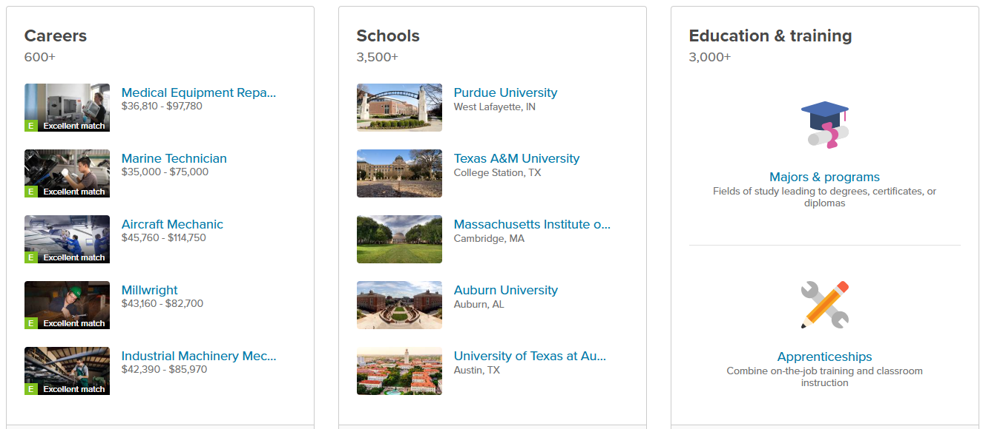
Explore

Slide 8
Where to being?
Student
ClassLink Tile:

Slide 9
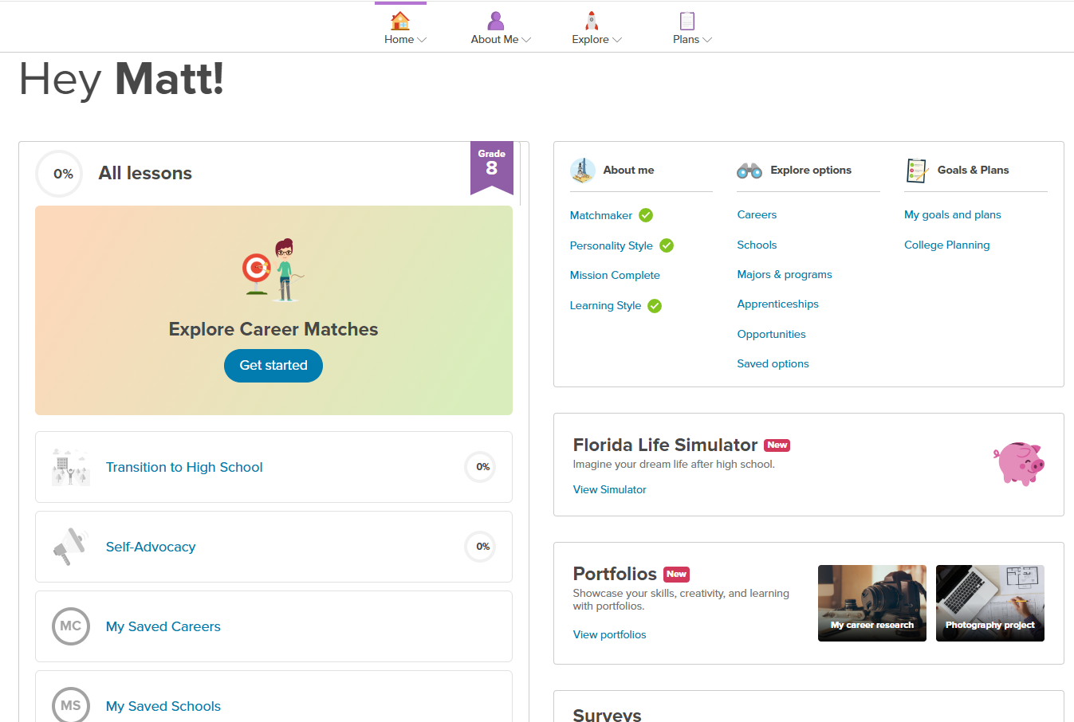

Slide 10
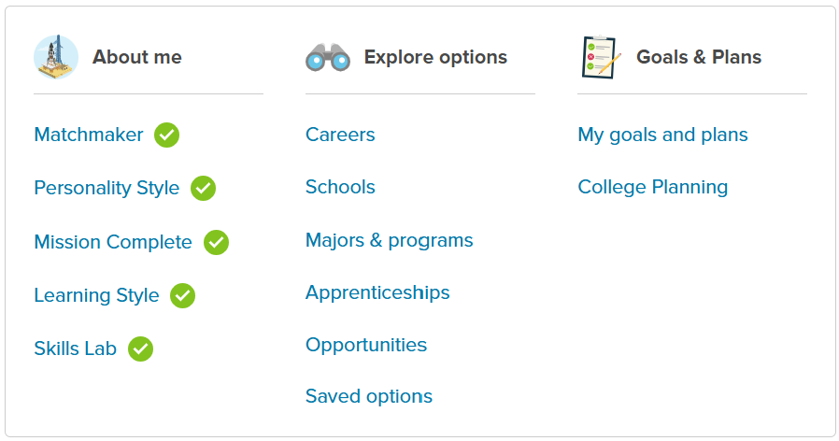
Where to being - Dashboard

Slide 11
Matchmaker - Results
Seniors
Freshmen

Slide 12
Personality Styles - Results
10th Grade
6th Grade

Slide 13
Helping K-12 students become future ready
Questions?

